Slide 1
Debugging with Eclipse
Author: Loh Jianxiong Christopher
Contributions: Chua Jie Sheng, Li Mengran, Peh Shao Hong, Oo Theong Siang, Tong Chun Kit, Tania Chattopadhyay

Slide 2
This tutorial assumes that you have already set up Eclipse.
If you haven’t, follow the ‘Getting Started With Eclipse’ Tutorial first.

Slide 3
Eclipse Debugger
Eclipse contains a powerful debugger that enables us to easily find and fix problems.
It lets us suspend a program during execution, in order to allow the user to step through the code line by line.
We will demonstrate the basic functionality of the debugger first and then debug a buggy program.

Slide 4
Create a new class called Search.
To demonstrate the functions of the Debugger, we will be using this piece of code:
public class Search {
public static void main(String[] args) {
int[] array = { 1, 2, 3, 4, 5, 6, 7, 8, 9, 10 };
boolean result = searchArray(array, array.length, 15);
System.out.println(result);
}
public static boolean searchArray(int[] a, int length, int x) {
boolean isFound = false;
for (int index = 0; index < length; index++) {
if (a[index] == x) {
isFound = true;
}
}
return isFound;
}
}

Slide 5
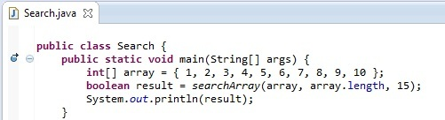
Breakpoints
Before we can begin debugging, we need to set a breakpoint.
Whenever the debugger encounters a breakpoint, the program will be suspended to allow the user to start debugging.
To set a breakpoint, double click on the left margin in the editor window. To remove a breakpoint, double click on it again.
If no breakpoint is set, the debugger will automatically suspend only if it encounters an exception during runtime.
Here a breakpoint has been set next to the main method. When we start the debugger, the program will suspend when it reaches this point in the code.

Slide 6
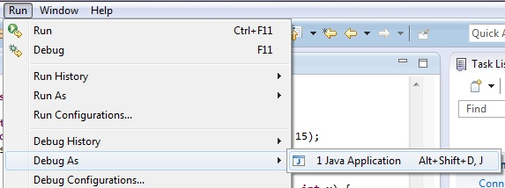
Running The Debugger
To run the Debugger, select
Run -> Debug As -> Java Application
This brings Eclipse to the Debug Perspective

Slide 7
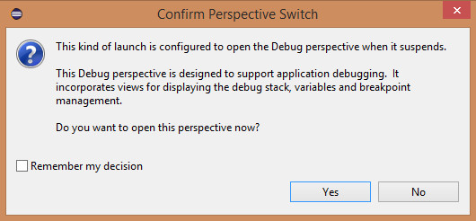
If the ‘Confirm Perspective Switch’ window appears, click ‘Yes’.

Slide 8
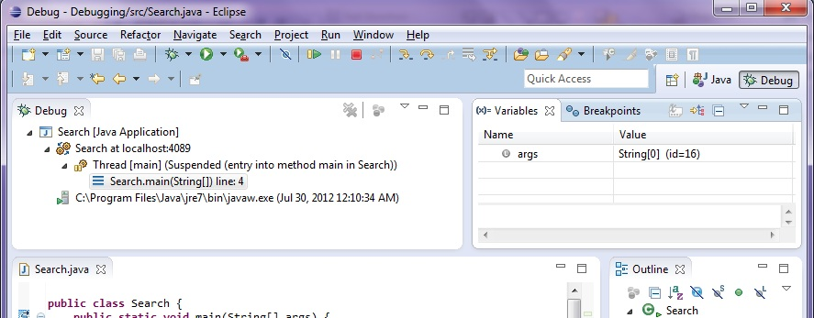
Perspectives
Notice how this changed from ‘Java’ to ‘Debug’
Now the IDE is in debug ‘perspective’.
A perspective is a set of views and windows. It provides the user with the necessary views and windows for a certain task.
The default perspective that we have seen so far is the ‘Java’ perspective, and is used for coding.
When Eclipse debugger is run, the workbench automatically switches to the ‘Debug’ perspective.

Slide 9
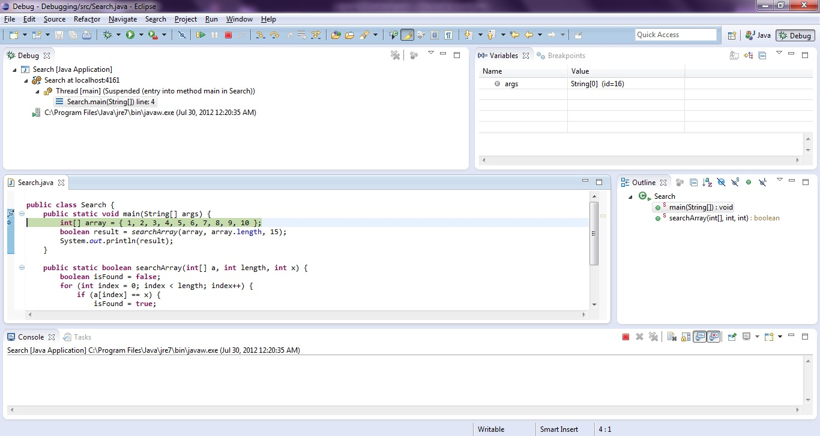
Debug Perspective
These are the main components of the debug perspective.
Variables associated with current stack
Program stack frame
Editor window. The next line to be executed is highlighted

Slide 10
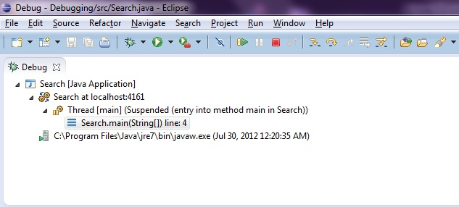
Stepping Through Code
These 3 buttons, “Step Into”, “Step Over” and “Step Return”, allows the user to Navigate through the code
Step Into (F5) : Moves into the method or constructor at the current line
Step Over (F6): Executes current line and suspend at the next line
Step Return (F7): Executes until the current function returns and pauses immediately

Slide 11
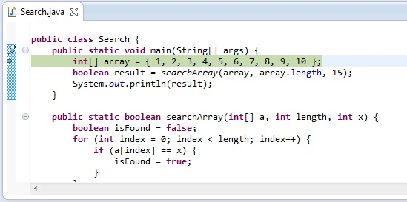
Step Over
Using Step Over, the debugger will go through the code one line at a time

Slide 12
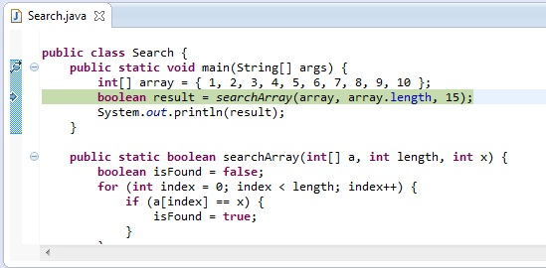
Step Over
Using Step Over, the debugger will go through the code one line at a time

Slide 13
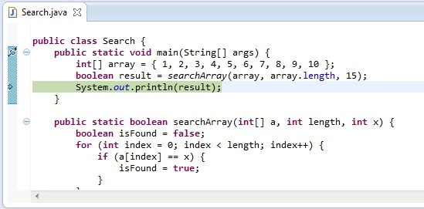
Step Over
Using Step Over, the debugger will go through the code one line at a time

Slide 14
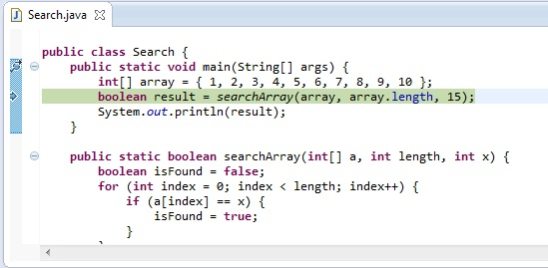
Step Into
If there is a method or constructor in the current line, Step Into can be used to move into the method

Slide 15
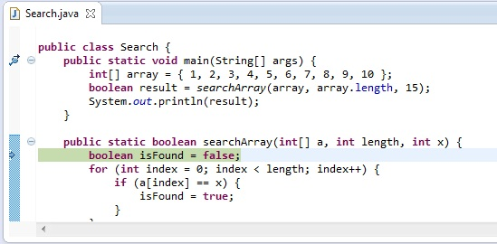
Step Into
If there is a method or constructor in the current line, Step Into can be used to move into the method

Slide 16
Step Return
If we are in the middle of a method execution, Step Return will execute until the end of current method and returns to the next line of the calling method.

Slide 17
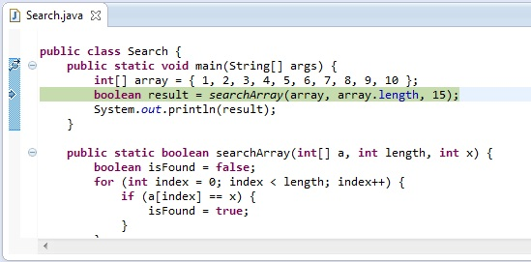
Step Return
If we are in the middle of a method execution, Step Return will execute until the end of current method and returns to the next line of the calling method.

Slide 18
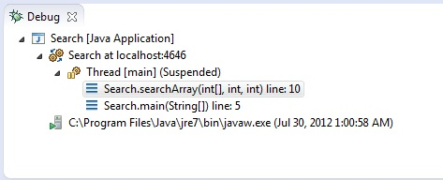
Stepping Through Code
The program stack frame can help us understand and find out where we are in the current program execution. As calls to methods are made, they are added on top of the ‘stack’. As methods are exited, they are removed from the ‘stack’
From the above example, we can see that we are currently executing the searchArray method, and that it was called by the main method

Slide 19
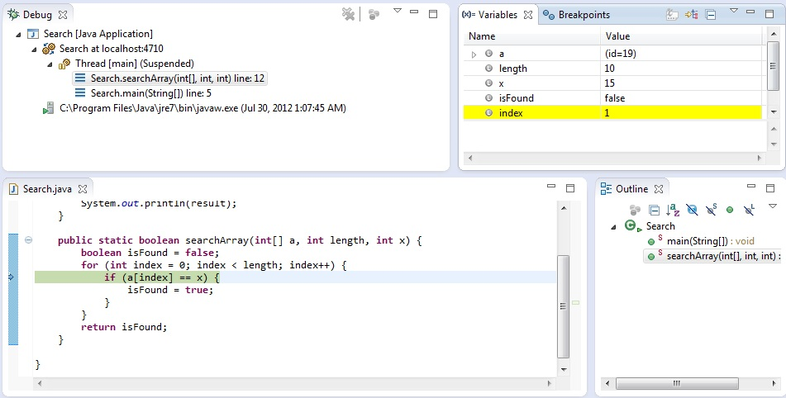
Stepping Through Code
We can select different stack frames here to inspect
As we step through the code, the variables window automatically updates the values of each variable. Highlighted rows show the variables which changed.

Slide 20
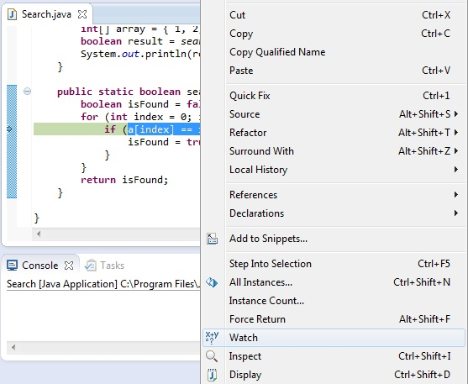
Expressions
The variables window automatically keeps track of variables in the current scope of execution.
Eclipse can also keep track of expressions, for example we can add a[index], or a[index]==x to the expressions window to examine its value at any time during execution
To add an expression to the expression window, highlight it in the editor window of the Debug Perspective, right click and select Watch.

Slide 21
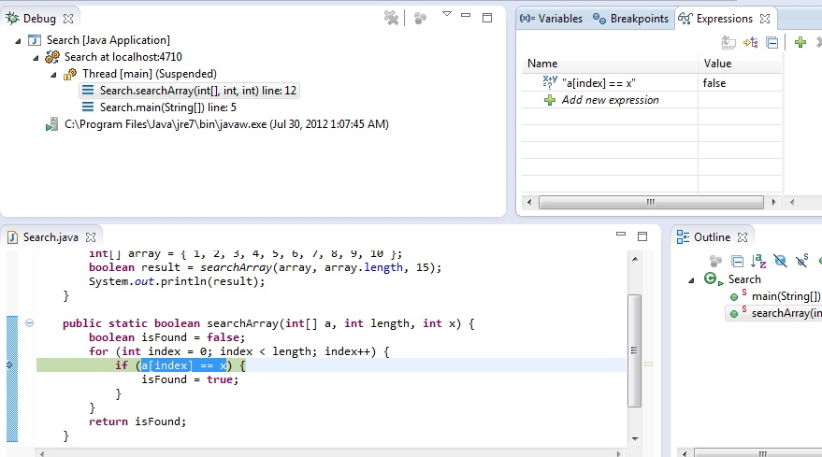
Expressions
Expressions may also be added manually, by clicking “Add new expression”

Slide 22
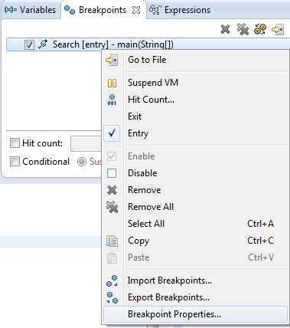
Conditional Breakpoints
Conditional breakpoints may be used to give the user more flexibility when debugging
To set conditions on
a breakpoint, select
the “Breakpoints” tab,
right click on a
breakpoint, and select
“Breakpoint Properties…”

Slide 23
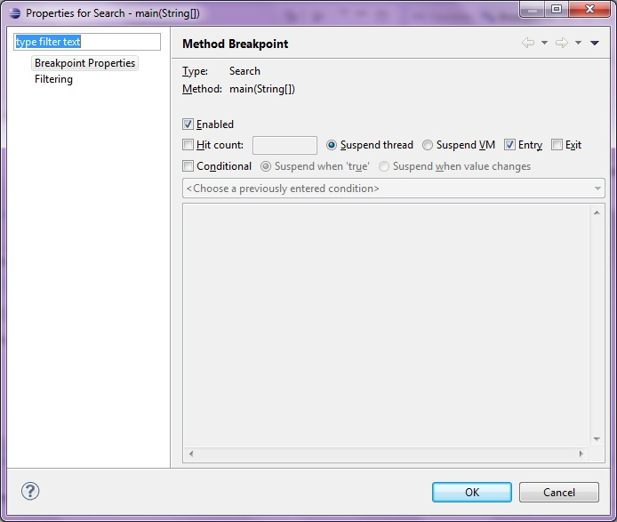
Conditional Breakpoints
Hit count: This option will only suspend the program after the breakpoint has been hit a specified number of times. This is useful when large loops are involved.
Conditional: This option will only suspend the program if the specified condition is true, or if the value of the condition changes.

Slide 24
Self-test Assignment: Buggy Sort
Now time to get our hands dirty.
Create a new Java project.
Add a new class called “BuggySort”
Copy the contents of BuggySort class in the next slide into the “BuggySort” class your created.
It is supposed to print an array, sort it then print the sorted array.
Now run the program.

Slide 25
public class BuggySort {
public static void main(String args[]) {
int data[] = {45, 2, 33, 11, 5, 9, 7, 21, 10, 67, 99, 123, 42, 81, 100, 54};
System.out.println("our numbers:");
printArray(data, 0, 15);
System.out.println();
bubbleSort(data, 0, 15);
System.out.println("after sorting:");
printArray(data, 0, 15);
System.out.println();
}
public static void printArray(int[] arr, int startIndex, int endIndex) {
int i;
for (i = startIndex; i <= endIndex; i++) {
System.out.print(arr[i] + " ");
}
System.out.println();
}
public static void bubbleSort(int[] arr, int startIndex, int endIndex) {
int i, j, temp;
for (i = endIndex; i > startIndex; i--) {
for (j = startIndex; j < i; i++) {
if (arr[j] > arr[j + 1]) {
temp = arr[j];
arr[j] = arr[j + 1];
arr[j + 1] = temp;
}
}
}
}
}

Slide 26

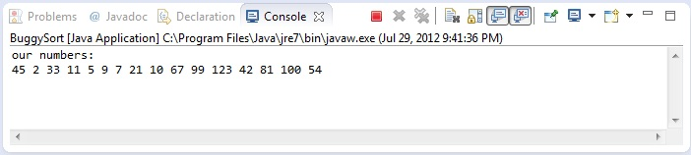
Expected output and Actual output
Expected output that we’d like to see
Actual output:
The program actually hangs after printing the initial array
Now press the red rectangular button to stop execution

Slide 27
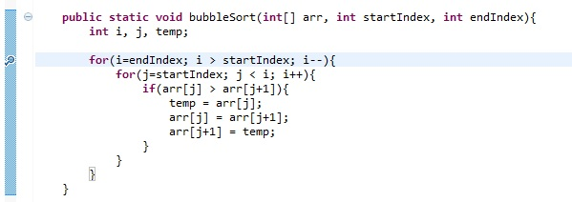
Start Debugging
Since the initial array is printed with no problem. We suspect that it’s the sorting function that enters an infinite loop, causing the program to hang.
Set a breakpoint at the start of the outer loop, and start debugging by selecting Run -> Debug As -> Java application

Slide 28
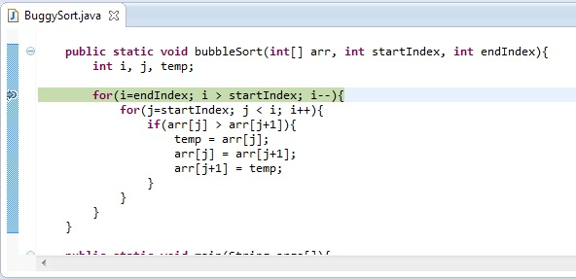
Step through the inner loop once
Now the program pauses at the starting point of the outer loop. We want to check the loop indices as the loops step through iterations.
So, step through the inner loop once and pause at the start of the inner loop.

Slide 29
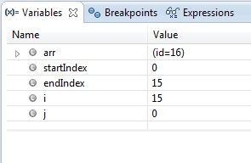
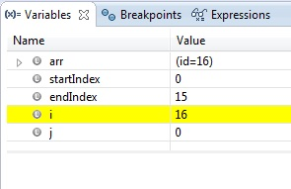
Check loop indices
Current loop indices i and j have values of 15 and 0 respectively, which are correct.
As we step over the wrapping up of the loop, we notice the value of i has changed from 15 to 16, as highlighted by the IDE with the yellow color. This is wrong, we were expecting j to increment.

Slide 30
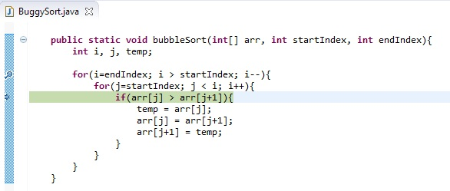
Locating and correcting the error
As we examine the code more closely, we find that what should have been “j++” was wrongly typed as “i++”.
Correct it, remove the breakpoint and run again, we should see the program behave correctly.

Slide 31
End

